Slide 1
Multi-View Vertebra Localization and Identification from CT Images
Han Wu¹, Jiadong Zhang¹, Yu Fang¹, Zhentao Liu¹, Nizhuan Wang¹,
Zhiming Cui ^{1,} , and Dinggang Shen ^{1,2,3,}
¹ School of Biomedical Engineering, ShanghaiTech Univerisity, Shanghai, China
² Shanghai United Imaging Intelligence Co. Ltd., Shanghai, China
³ Shanghai Clinical Research and Trial Center, Shanghai, China
cuizhm@shanghaitech.edu.cn, dgshen@shanghaitech.edu.cn

Slide 2
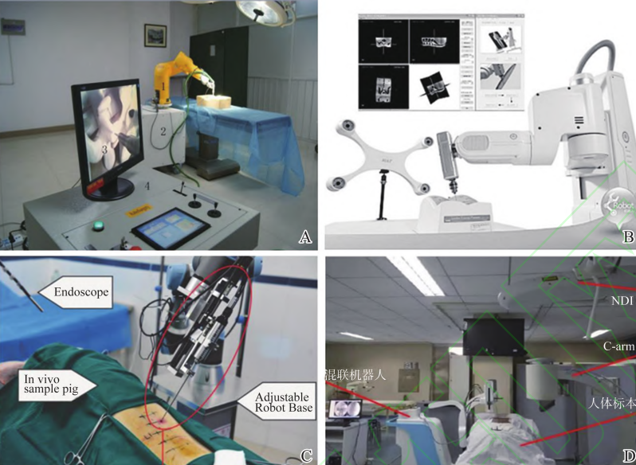
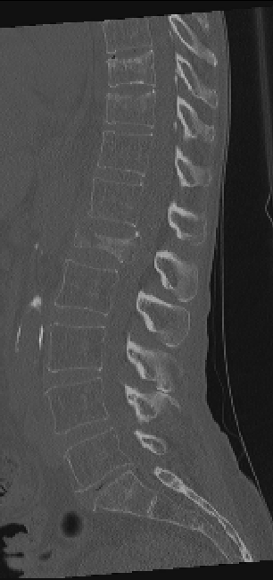
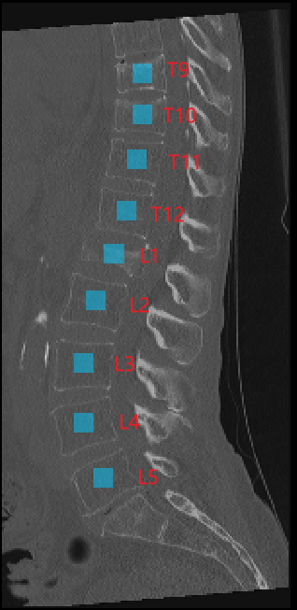
Overall Goal
Vertebra Localization and Identification
T9
T10
T11
T12
L1
L2
L3
L4
L5
CT scan
labeling results
(A,C) surgical planning; (B) pathological diagnosis. (C) post-operative evaluation
Fuxin, Du et al. “Research advances of spine surgery robot.“, Journal of Shandong University(Health Sciences), 2023

Slide 3
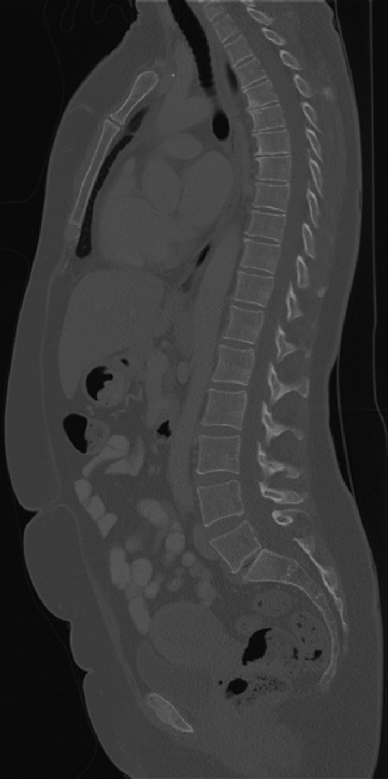
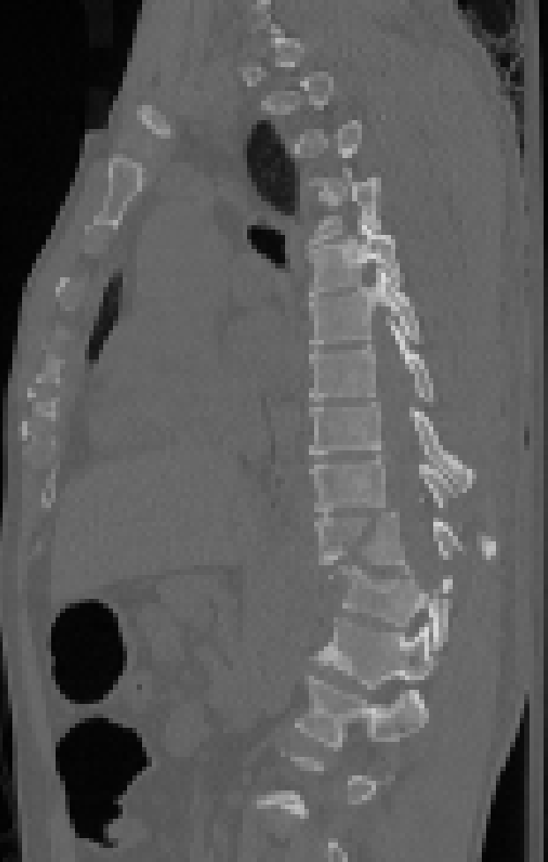
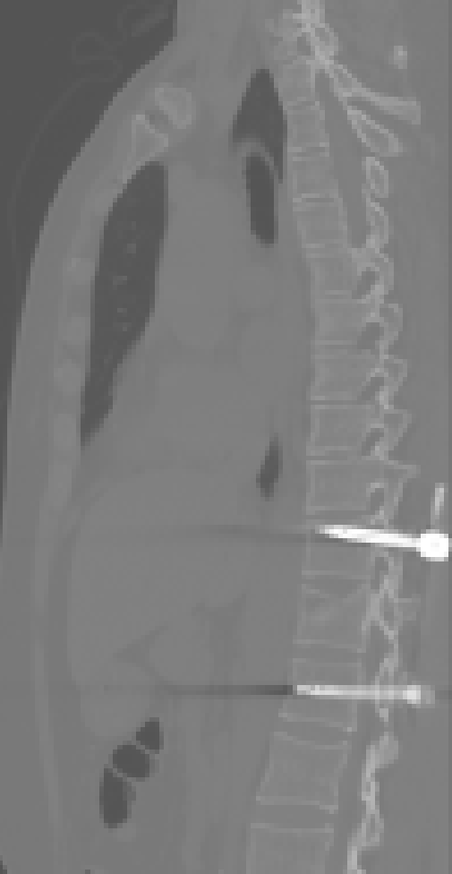
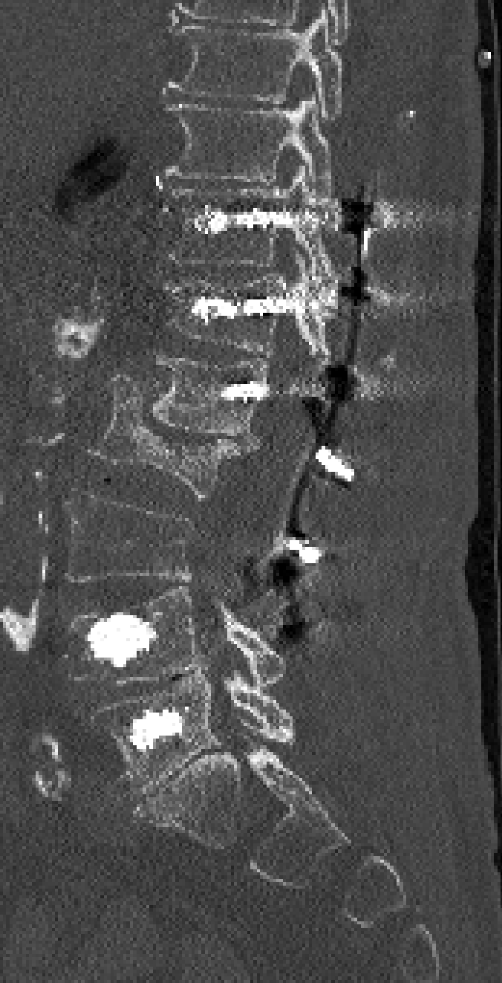
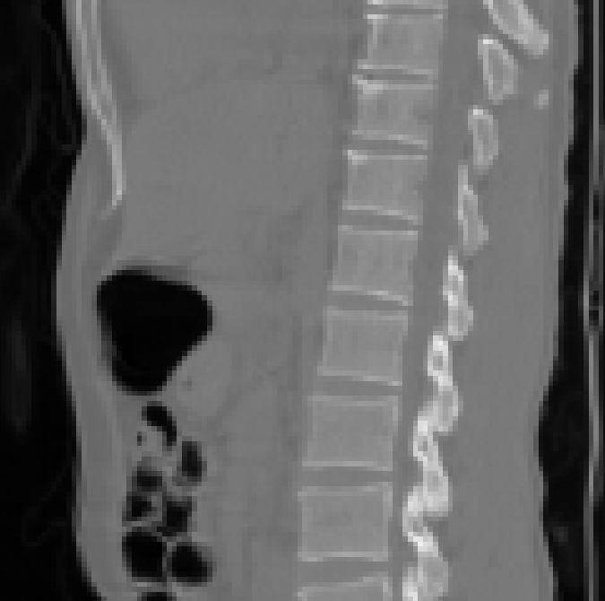
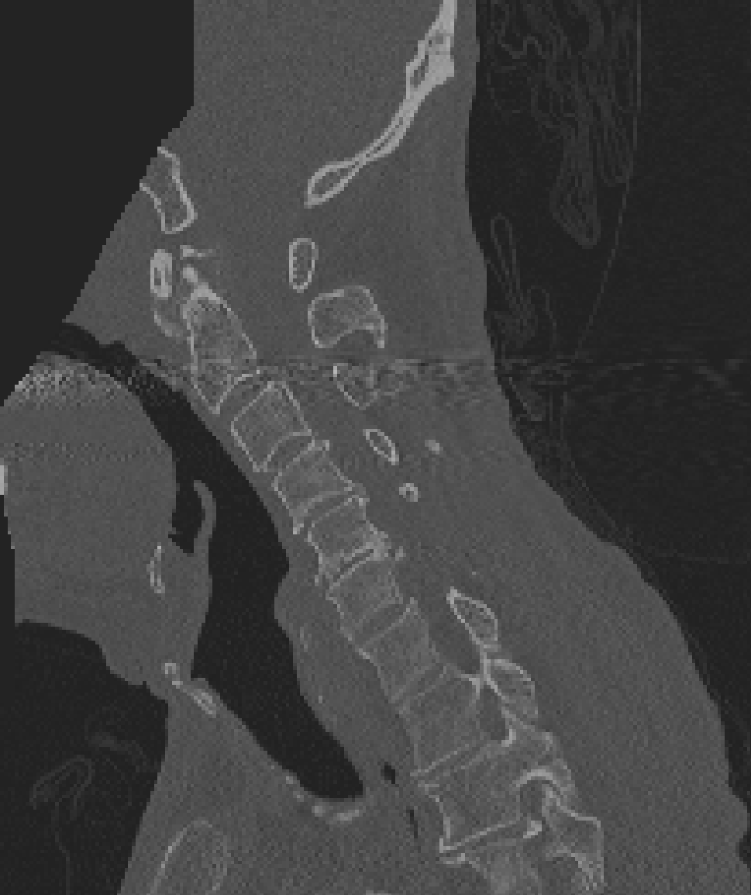
Summary of
Related Work
Intrinsic Challenges:
Significant shape variations of vertebrae with different categories (a)
Close shape resemblance of neighboring vertebrae (b,d)
Image with arbitrary field of view (a,b,d)
Spine with pathological fracture (c)
Presence of metal implant artifacts (e,f)
Shortcomings of Current SOTA:
Lack of global and sequential information of a scan resulted from the 3D patch-wise cropping method.
Large computation cost of processing 3D data and model.
Serve overfitting problems due to the lack of pre-trained models in 3D medical imaging using a small dataset.
( a )
( c )
( e )
( f )
( d )
( b )

Slide 4
Multi-View Vertebrae Localization and Identification from CT Images

Slide 5
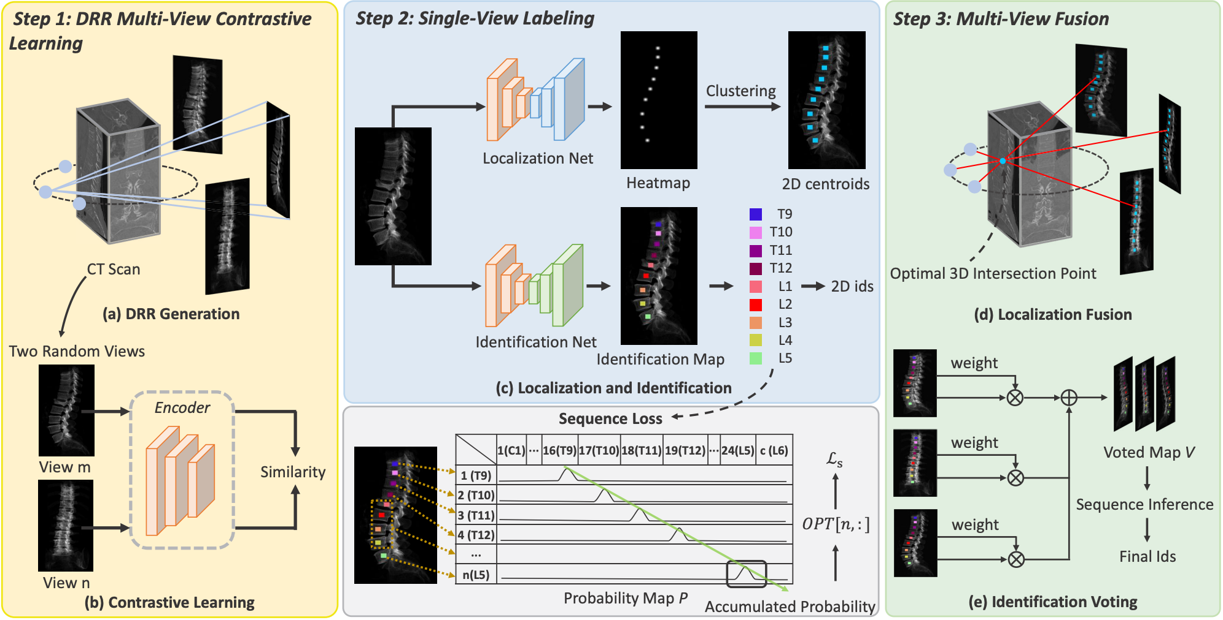
Multi-View Vertebrae Localization and Identification from CT Images

Slide 6
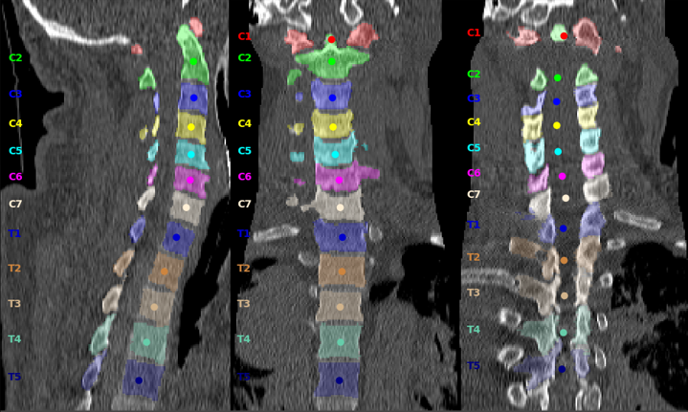
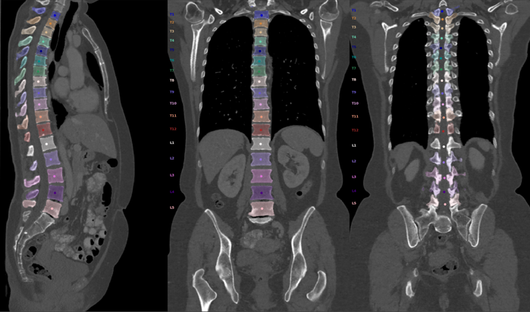
Dataset and Evaluation Metrics
Dataset:
MICCAI Challenge VerSe19 dataset
160 CT scans in total
A large-scale in-house dataset
500 CT scans in total
Evaluation Metrics:
L-Error(mm): The average Euclidean distance between the ground truth and predictions.
Id-Rate(%): The ratio of correctly identified vertebrae to the total number of vertebrae.
Sekuboyina, Anjany, et al. "VerSe: A vertebrae labelling and segmentation benchmark for multi-detector CT images." Medical image analysis 73 (2021): 102166.

Slide 7
Evaluation Results
Quantitatively Results on MICCAI VerSe19 dataset:
Method | Test Dataset |  | Hidden Dataset
 | Id-Rate(%) | L-Error(mm) | Id-Rate(%) | L-Error(mm)
Payer C. | 95.65 | 4.27 | 94.45 | 4.80
Lessmann N. | 89.86 | 14.12 | 90.42 | 7.04
Chen M. | 96.94 | 4.43 | 86.73 | 7.13
Sekuboyina A. | 89.97 | 5.17 | 87.66 | 6.56
Ours | 98.12 | 1.79 | 96.45 | 2.17
Sekuboyina, Anjany, et al. "VerSe: A vertebrae labelling and segmentation benchmark for multi-detector CT images." Medical image analysis 73 (2021): 102166.

Slide 8
Ablation Study
Ablation of each components
We build the basic network for the vertebra localization and identification with K=10, denoted as Baseline. Pre-train, Sequence Loss, and voting represent the addition of the multi-view contrastive learning, Sequence Loss, and multi-view voting one by one.
Baseline | Pre-train | Sequence Loss | Voting | Id-Rate(%)
 |  |  |  | Test Dataset | Hidden Dataset
√ |  |  |  | 84.00 | 83.45
√ | √ |  |  | 85.58 | 86.52
√ | √ | √ |  | 89.41 | 90.54
√ | √ | √ | √ | 98.12 | 96.45

Slide 9
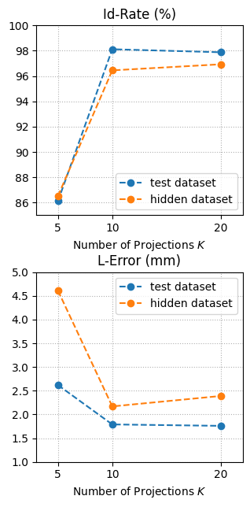
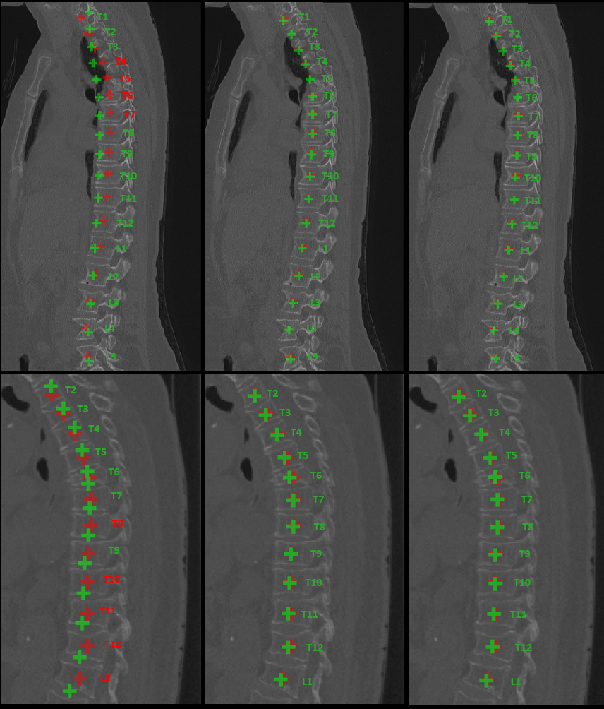
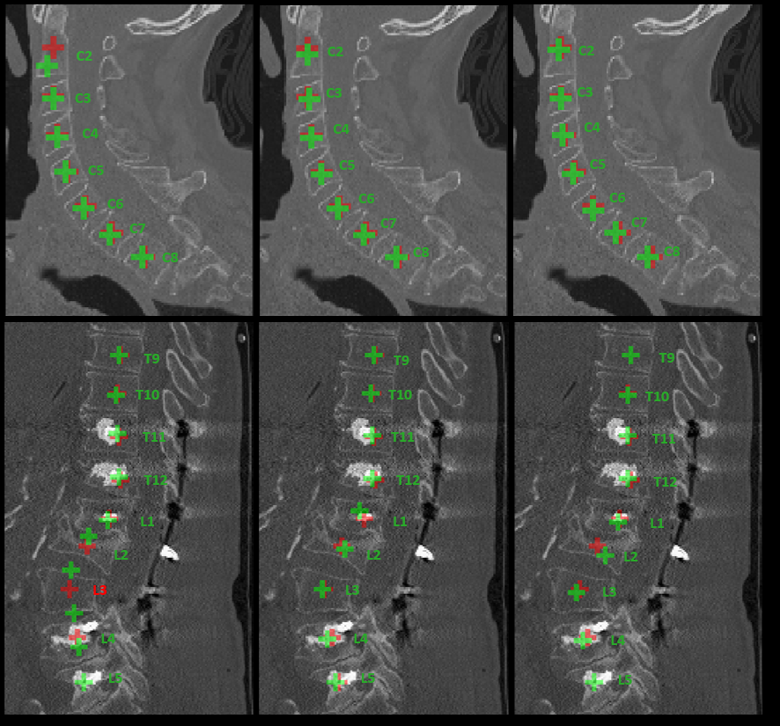
Ablation Study
Ablation of projection number K
5 Views
10 Views
20 Views
5 Views
10 Views
20 Views

Slide 10
Additional Results
Quantitatively results on a large-scale in-house dataset collected in real-world clinics:
500 scans in total: 300 scans for training, 100 for testing and 100 for validation
With all the components and K set to 10
 | Test Dataset
 | Id-Rate(%) | L-Error(mm)
Cer. | 99.55 | 1.51
Tho. | 99.00 | 1.48
Lum. | 99.54 | 1.50
All | 99.04 | 1.49

Slide 11
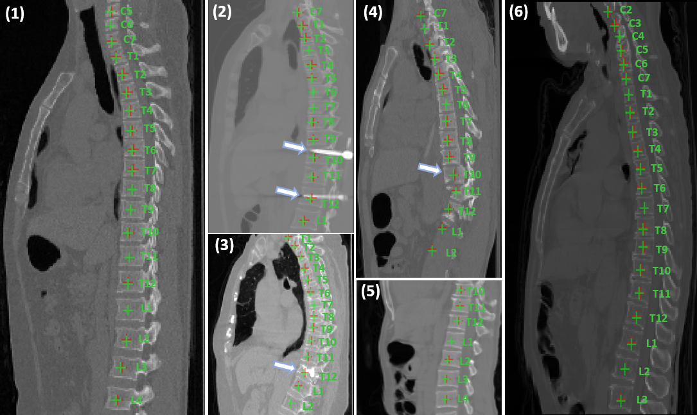
Additional Results
Qualitatively results on typical challenging cases: large field of view(1, 6), metal artifacts (2, 3), pathological spines (4), and limited field of view (5).(Green for prediction and red for ground truth.)

Slide 12
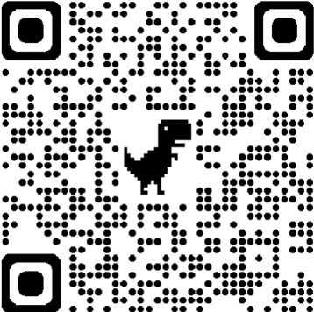
Thank you!
Paper
Code

